Slide 1
Tutorial 1 CSI3130-Database II
20th September 2022

Slide 2
Hybrid Merge join
A hybrid merge-join technique that combines indices with merge join. suppose that one of the relations is sorted; the other is unsorted, but has a secondary b+-tree index on the join attributes.
The hybrid merge-join algorithm merges the sorted relation with the leaf entries of the secondary b+-tree index.
The result file contains tuples from the sorted relation and addresses for tuples of the unsorted relation.
The result file is then sorted on the addresses of tuples of the unsorted relation, allowing efficient retrieval of the corresponding tuples, in physical storage order to complete the join.

Slide 3
Hybrid Merge join
In other words, scan the unsorted relation in physical address order and merge with the previous result to replace addresses by the actual tuples.
NOTE: Sequential scan is more efficient than the random lookup.

Slide 4
Practice Exercises
Q1) Assume (for simplicity in this exercise) that only one tuple fits in a block and memory holds at most three blocks. Show the runs created on each pass of the sort-merge algorithm when applied to sort the following tuples on the first attribute: (kangaroo, 17), (wallaby, 21), (emu, 1), (wombat, 13), (platypus,3), (lion, 8), (warthog, 4), (zebra, 11), (meerkat, 6), (hyena, 9), (hornbill, 2), (baboon, 12).
Note: Output of the merge isn’t buffered in memory, but written directly to disk.

Slide 5
Answer 1
We will refer to the tuples (kangaroo, 17) through (baboon, 12) using tuple numbers t1 through t12. We refer to the jth run used by the ith pass, as rij . The initial sorted runs have three blocks each. They are:
r11 = {t3, t1, t2} r13 = {t9, t7, t8}
r12 = {t6, t5, t4} r14 = {t12, t11, t10}
Each pass merges three runs. Therefore the runs after the end of the first pass are:
r21 = {t3, t1, t6, t9, t5, t2, t7, t4, t8}
r22 = {t12, t11, t10}
At the end of the second pass, the tuples are completely sorted into one run:
r31 = {t12, t3, t11, t10, t1, t6, t9, t5, t2, t7, t4, t8}

Slide 6
Practice Exercises
Q2) Let relations r1(A, B, C) and r2(C, D, E) have the following properties: r1 has 20,000 tuples, r2 has 45,000 tuples, 25 tuples of r1 fit on one block, and 30 tuples of r2 fit on one block.
Estimate the number of block transfers required using each of the following join strategies for r1 ⋈ r2:
a. Nested-loop join.
b. Block nested-loop join.
c. Merge join.
d. Hash join.

Slide 7
Answer 2
r1 needs 800 blocks, and r2 needs 1500 blocks. Let us assume M pages of memory. If M > 800, the join can easily be done in 1500 + 800 disk accesses, using even plain nested-loop join. So we consider only the case where M<=800 pages.
a. Nested-loop join:
Using r1 as the outer relation, we need 20000 * 1500 + 800 = 30, 000, 800 disk accesses. If r2 is the outer relation, we need 45000 * 800 + 1500 = 36, 001, 500 disk accesses.
b. Block nested-loop join:
If r1 is the outer relation, we need 800 * 1500+800 disk accesses.
If r2 is the outer relation, we need 1500 * 800 + 1500 disk accesses

Slide 8
Answer 2
C. Merge join:
Assuming that r1 and r2 are not initially sorted on the join key, the total sorting cost inlcusive of the output is
Bs = 1500(2[logM-1(1500/M)]+2) + 800(2[logM-1(800/M)] + 2) disk accesses. Assuming all tuples with the same value for the join attributes, If in memory, the total cost is Bs + 1500 + 800 disk accesses.
d. Hash join:
We assume no overflow occurs. Since r1 is smaller, we use it as the build relation and r2 as the probe relation.
If M >800/M, i.e., no need for recursive partitioning, then the cost is 3(1500 + 800) = 6900 disk accesses, else the cost is 2(1500+800)[logM-1(800)*1]+1500+800 disk accesses.

Slide 9
Practice Exercises
Q3) Consider the bank database below, where the primary keys are underlined.
branch(branch_name, branch_city, assets)
customer (customer_name, customer_street, customer_city)
loan (loan_number, branch_name, amount)
borrower (customer_name, loan_number)
account (account_number, branch_name, balance)x
depositor (customer_name, account_number)
Suppose that a B+-tree index on branch city is available on relation branch, and that no other index is available. List different ways to handle the following selections that involve negation:
a. σ￢(branch city<“Brooklyn”)(branch)
b. σ￢(branch city=“Brooklyn”)(branch)
c. σ￢(branch city<“Brooklyn” ∨ assets<5000)(branch)

Slide 10
Answer 3
a) Use the index to locate the first tuple whose branch-city field has value “Brooklyn”. From this tuple, follow the pointer chains till the end, retrieving all the tuples.
b) For this query, the index serves no purpose. We can scan the file sequentially and select the tuples whose branch_city other than “Brooklyn”.
c) this query is equivalent to:
σ(branch_city>=“Brooklyn” ^ assets>=5000)(branch)
Using branch_city index, we can retrieve all the tuples with branch_city greater than/equal to “Brooklyn” by following the pointer chains from the first Brooklyn tuple. Here, we also apply the additional criteria of assets which are greater than/equal to 5000 on every tuple.

Slide 11
Practice Exercises
Q4) Suppose you need to sort a relation of 40 gigabytes, with 4-kilobyte blocks, using a memory size of 40 megabytes. Suppose the cost of a seek is 5 milliseconds, while the disk transfer rate is 40 megabytes per second.
a. Find the cost of sorting the relation, in seconds, with bb = 1 and with bb = 100.
b. In each case, how many merge passes are required?
c. Suppose a flash storage device is used instead of a disk, and it has a latency of 20 microsecond and a transfer rate of 400 megabytes per second. Recompute the cost of sorting the relation, in seconds, with bb = 1 and with bb = 100, in this setting.

Slide 12
Answer 4
Main memory = 40mb = 40 x 10⁶
Block size available = 4kb = 4 x 10³
M = total blocks = 40mb/ 40kb = 10⁴
b_{r} = Relation blocks required = 40gb/ 4kb = 10⁷
(a) cost = block transfers time + seek time
no of block transfers = b_{r}(2[ log_{M-1}(b_{r}/M) ]^{ceil} + 1)
= 3 x 10⁷

Slide 13
Answer 4
Seeks when bb = 1: = 2[b_{r} /m]^{ceil} + [b_{r} /b_{b}] ^{ceil} (2[ log_{M-1}(b_{r}/M) ]^{ceil} - 1)
= 10002 x 10³
when bb = 100:
= 102 x 10³

Slide 14
Answer 4
Block transfer time = 4kb/ 40mb = 10⁻⁴s
Seek time = 5ms = 5 x 10⁻³s when bb = 1: = (block transfer cost * block transfer time) + (seek cost * seek time)
= 53,010s
when bb = 100:
= 3,510s

Slide 15
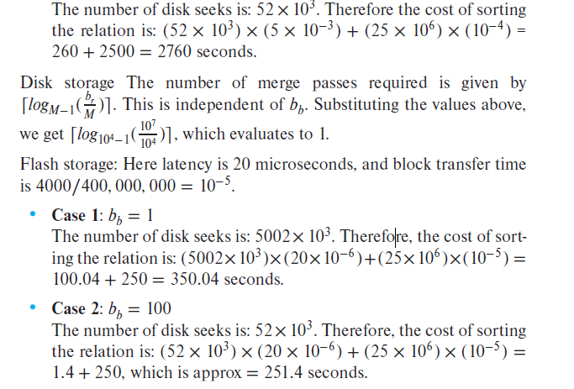
Answer 4
Case 2: bb = 100

Slide 16
Practice Exercises
Q5) Design a variant of the hybrid merge-join algorithm for the case where both relations are not physically sorted, but both have a sorted secondary index on the join attributes.

Slide 17
Answer 5
We merge the leaf entries of the first sorted secondary index with the leaf entries of the second sorted secondary index. The result file contains pairs of addresses, the first address in each pair pointing to a tuple in the first relation, and the second address pointing to a tuple in the second relation. This result file is first sorted on the first relation’s addresses. The relation is then scanned in physical storage order, and addresses in the result file are replaced by the actual tuple values. Then the result file is sorted on the second relation’s addresses, allowing a scan of the second relation in physical storage in order to complete the join.

